Slide 1
R1 Basic Planning Knowledge Factor
Yushi Chang
09/30/2021

Slide 2
Basics of Radiation Physics
Photon interactions
Radiation equilibrium and charged particle equilibrium
Cavity theory
Detectors and dosimeters

Slide 3
Sc
Definition
Collimator scatter factor/ in-air output ratio: ratio of output in air for a given field to that for a reference field at SAD.
How to measure it, especially for small field size and high energy beam?
Ion chamber with buildup cap fully covered by the field without penumbra (at least 1cm between the field edge and buildup cap)
For small field size/high energy beam, use miniphantom or measure at distances larger than SAD and apply ISL.
What is collimator inter-change effect and how does it affect Sc?
Sc of 2*10 cm field would be different from that of 10*2 cm field

Slide 4
Sp
Definition
Phantom scatter factor: ratio of dose rate for a given field at a reference depth to that at the same point and depth for a reference field in phantom
How to measure it, especially for small field size and high energy beam?
Ion chamber with buildup cap fully covered by the field without penumbra (at least 1cm between the field edge and buildup cap)
For small field size/high energy beam, use miniphantom or measure at distances larger than SAD and apply ISL.

Slide 5
PDD
Define PDD
Quotient of absorbed dose at depth d to that at a reference depth d₀ along the central axis, which should determined for a small field size (3*3 cm2) to minimize electron contamination.
Factors affecting PDD
Beam quality (energy)
Depth
Field size and shape
SSD
Beam collimation

Slide 6
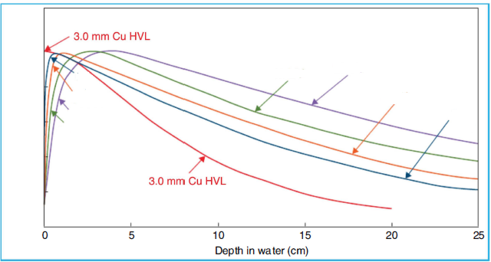
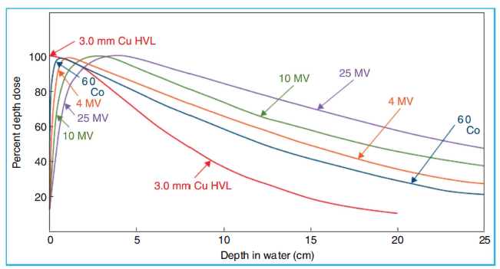
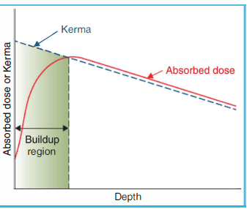
PDD
SSD=100; Field size=10*10
Energy of each curve?
dmax?
Entrance dose?
Dose at 10 cm?
Physics reason for build-up?
Combination of electrons depositing energy and photon attenuation
Another angle- transient equilibrium between KERMA and dose
How to estimate the depth of buildup region?

Slide 7
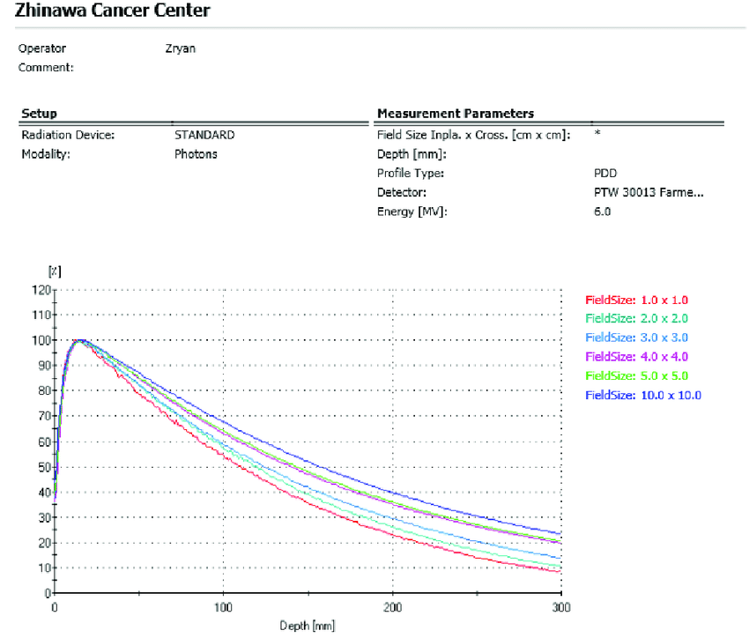
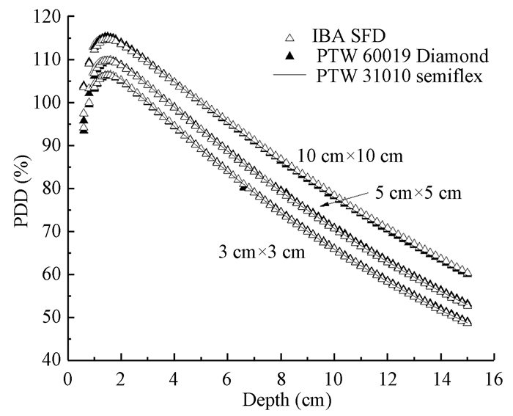
PDD
For a sufficiently small field, what factor determines the PDD?
Attenuation of primary radiation
As field size increases, what factor contributes to the PDD curve?
Scatter photons
How does the field size dependence of PDD change with energy?
It decreases with energy, because the scatter cross section decreases with increase in energy and higher-energy photons are scattered more prominently forward

Slide 8
PDD
What is y axis?
What does this figure indicate?
PDD increases with SSD as a result of inverse squire law
What is Mayneord factor? What’s it based on and what’s not considering

Slide 9
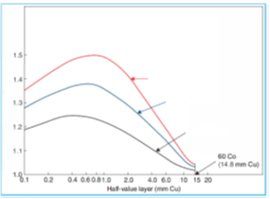
TAR
Define TAR
Why is TAR SSD independent?
Inverse square factor is cancelled out, attenuation only depends on depth, scatter is not obvious
Variation with energy, depth and field size
Pretty much like PDD
What is backscatter factor?
TAR at dmax

Slide 10
TAR and PDD

Slide 11
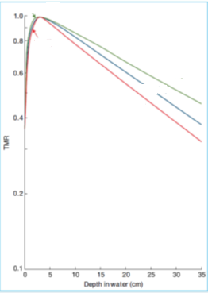
TPR/TMR
Definition
How does dmax change with field size and SSD?
dmax decreases with field size and increases with SSD, because electron contamination increases with field size and decreases with SSD
For TMR, research shows that the scatter only depends on field size and the depth and is independent of divergence. So TMR is SSD independent
TMR/TPR and PDD:
What beam energy is this?
What makes the curves different?

Slide 12
SAR, SPR, SMR
Define SAR
Ratio of scatter dose at a given point in the phantom to the dose in free space at the same point
Mathematically,

Slide 13
Equivalent Field size
Equivalent square?
Equivalent circle?
Irregular- Clarkson’s method. What’s the assumption? Where do we use it at Penn?
Assume scattered dose can be calculated separately from the primary dose. RadCalc

Slide 14
MU Calc

Slide 15
MU Calc

